Slide 1

DeepFake
汇报人：陈若愚 202118018629015
组员：朱子璇 202118018629006
赵剑儒 202128018670118
2022-06-20
Notes:
大家好，我叫陈若愚，今天我汇报的题目是DeepFake

Slide 2
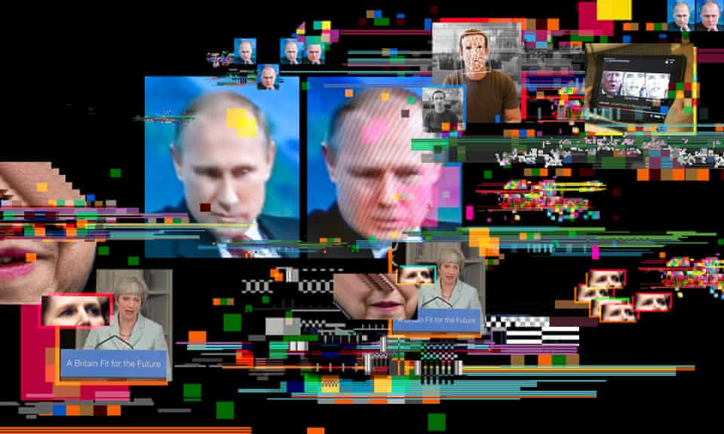

Slide 3
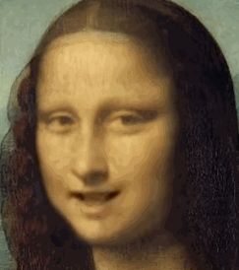
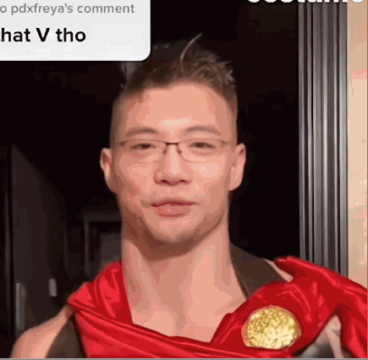
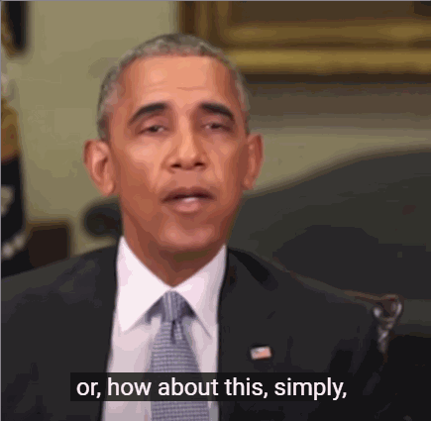
Deepfakes
Monalisa talk
“JiRouJinLun”
Obama call Trump “dipshit”
The 21st century’s answer to Photoshopping, deepfakes use a form of artificial intelligence called deep learning to make images of fake events, hence the name deepfake.
https://www.theguardian.com/technology/2020/jan/13/what-are-deepfakes-and-how-can-you-spot-them
Notes:
你见过奥巴马骂唐纳德·特朗普是“彻头彻尾的白痴”吗? 答案是肯定的，你见过deepfake。
deepfake是21世纪对photoshop的回应，它使用一种被称为深度学习的人工智能形式来制作假事件的图像，因此得名deepfake。

Slide 4
Overview
精读
[CVPR 2022] DeepFake Disrupter: The Detector of DeepFakeIs My Friend
[CVPR 2022] Protecting Celebrities From DeepFakeWith Identity Consistency Transformer
[CVPR 2020] Celeb-DF: A Large-Scale Challenging Dataset for DeepFakeForensics
[ECCV 2020] Two-branch Recurrent Network for Isolating Deepfakes in Videos
[CVPR 2021] Exploring Adversarial Fake Images on Face Manifold
[ICCV 2021] Artificial Fingerprinting for Generative Models: Rooting Deepfake Attribution in Training Data
陈若愚
略读
朱子璇
赵剑儒
Notes:
第一篇提出了一个大规模deepfake数据集Celeb-DF
第二篇设计了一个双分支结构来提取丰富特征，并通过设计损失函数学习到了一个更具有区分性的嵌入空间
第三篇设计了一种针对取证模型的对抗样本制作方法
第四篇证明了人工指纹可以从训练数据迁移到生成模型中，并出现在所有伪造数据中，通过人工指纹可以对deepfake进行检测和溯源

Slide 5
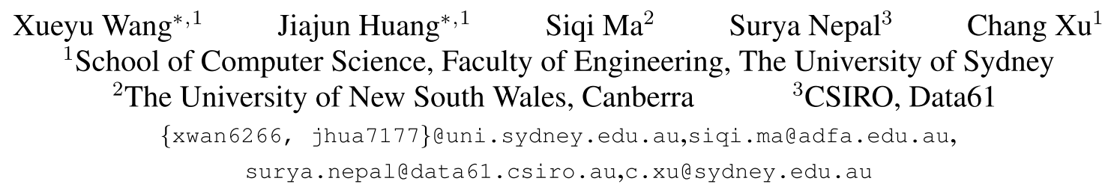
﻿DeepFake Disrupter: The Detector of DeepFake Is My Friend
CVPR 2022
Notes:
DeepFake破坏者:DeepFake的检测器是我的朋友
来自澳大利亚的一篇paper
悉尼大学
堪培拉，新南威尔士大学

Slide 6
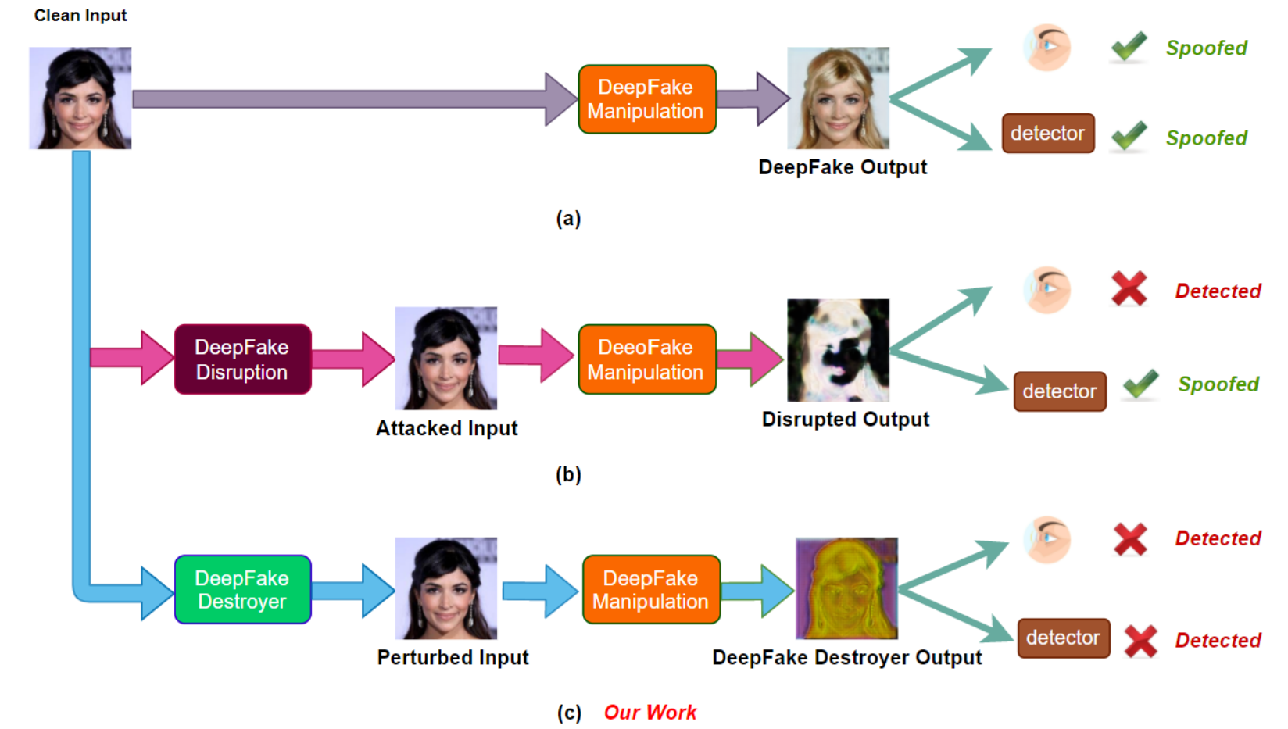
Figure 1. (a) shows that advanced DeepFake manipulation models can easily spoof human naked eye and DeepFake detector. (b) shows that after DeepFake Disruption, fake outputs become apparently distorted from the perspective of human eye, but can still spoof the DeepFake detector. (c) shows that our proposed method DeepFake disrupter can invalidate the DeepFake manipulation process from both human end and machine end.
Notes:
A表明先进的DeepFake操作模型可以很容易地欺骗人类肉眼和DeepFake检测器。
B在DeepFake Disruption之后，从人眼的角度来看，虚假输出明显扭曲，但仍能欺骗DeepFake检测器
如对源输入添加每扰动，将使DeepFake结果从人眼的角度看是扭曲的。然而，以前的方法并没有探索被破坏的图像是否仍然可以欺骗DeepFake探测器。
C我们提出的方法DeepFake干扰器可以从人端和机器端使DeepFake操作过程失效。

Slide 7
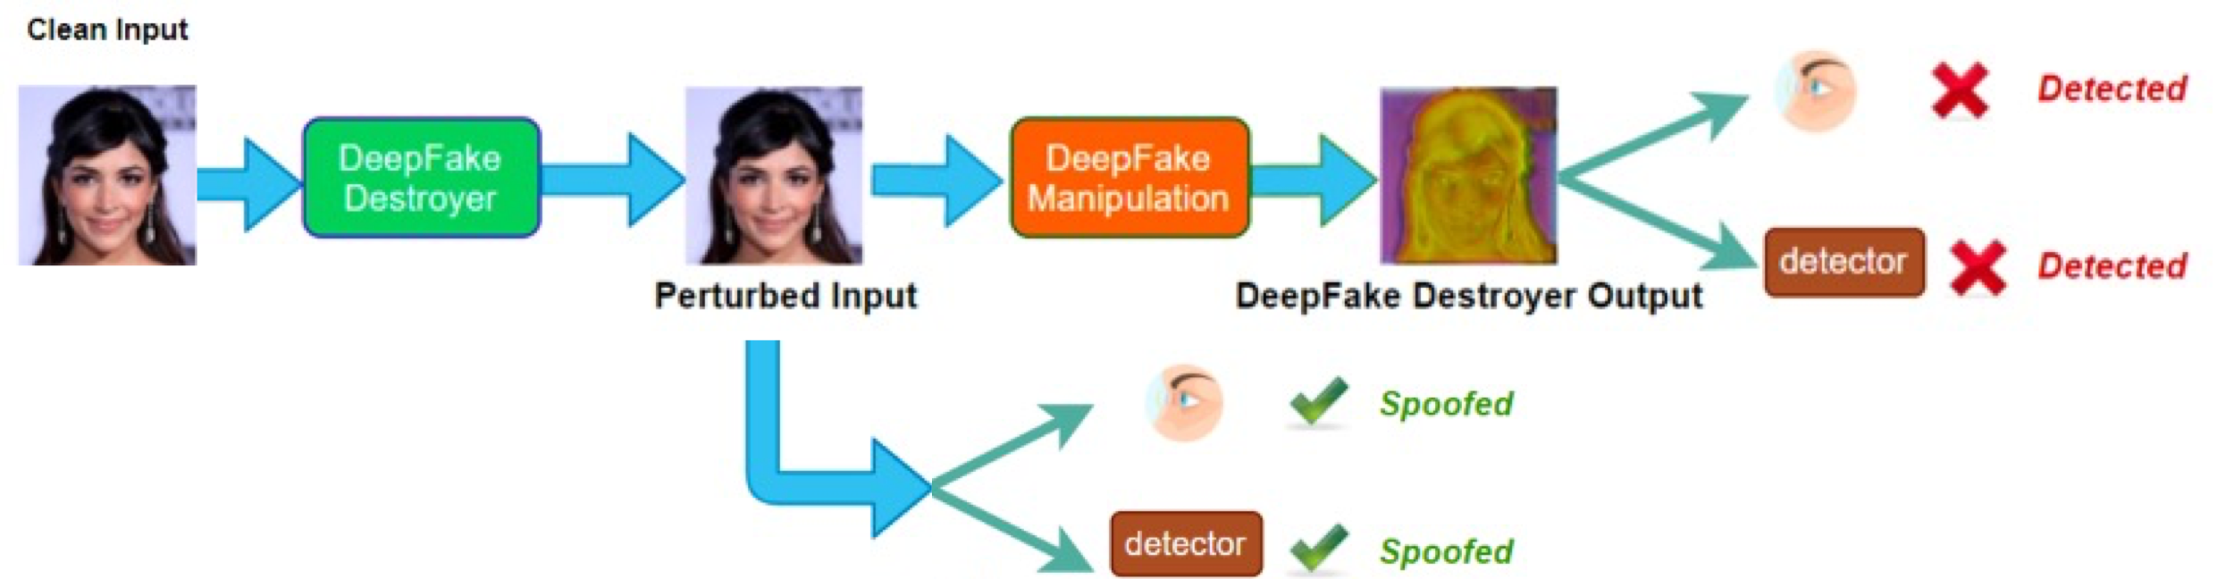
Contribution
This work proposed a novel framework, called DeepFake Disrupter, to defend against DeepFake with the help of the DeepFake detector.
The DeepFake Disrupter is a perturbation generator that takes as input real images and outputs a human-imperceptible perturbation so as to make the data generated by the DeepFake models be identified as fake by DeepFake detector and human eyes; meanwhile, the original real inputs injected with perturbations can still be identified as real by DeepFake detector.
﻿Experimental results on CelebA [13] and VoxCeleb1 [16] …
Key Technology:
﻿Adversarial attack and Adversarial Training
﻿DeepFake Data Generation
Proposed by this paper
Notes:
DeepFake Disrupter是一种扰动生成器，以真实图像为输入，输出人类难以察觉的扰动，从而使DeepFake模型生成的数据通过DeepFake检测器和人眼识别为假数据

Slide 8
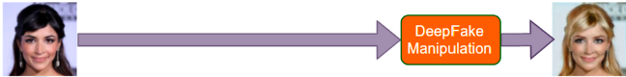
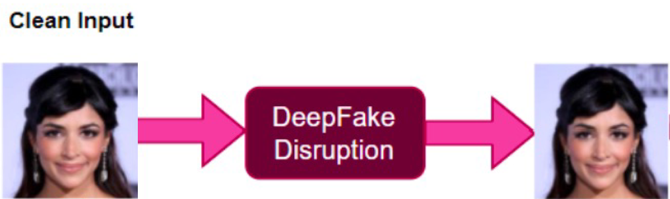
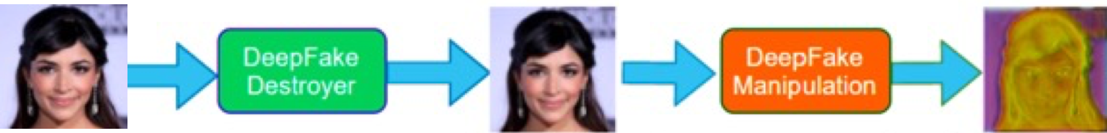
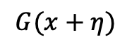
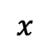
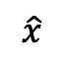
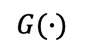
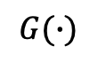
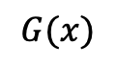
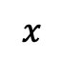
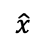
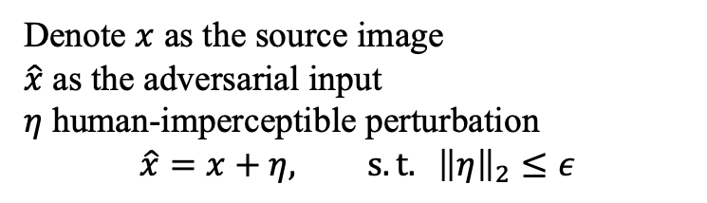
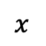
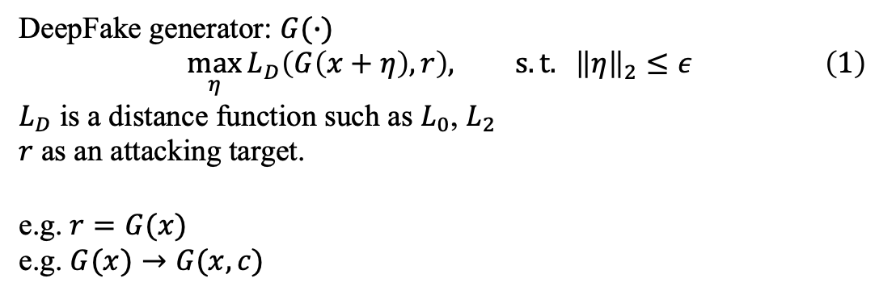
3.1. Adversarial Attacks to DeepFake
$$x$$
$$G(∙)$$
$$G(x)$$
$$x$$
$$\hat{x}$$
distance
$$x$$
$$\hat{x}$$
$$G(x+η)$$
$$G(∙)$$
﻿﻿Adversarial Attacks: add human-imperceptible perturbations on the source images
Source image
Perturbed image
Denote $x$ as the source image
$\hat{x}$ as the ﻿adversarial input
$η$ ﻿human-imperceptible perturbation
$$\hat{x}=x+η, s.t. {\left\|η\right\|}_{2}≤ε$$
﻿DeepFake generator: $G(∙)$
$$\begin{aligned}\max_{η}{L_{D}\left(G\left(x+η\right),r\right), s.t. {\left\|η\right\|}_{2}≤ε}\#\left(1\right)\end{aligned}$$
$L_{D}$ is a distance function such as $L_{0}$, $L_{2}$
$r$ as an attacking target.
e.g. $r=G(x)$
e.g. $G(x)→G(x,c)$
Notes:
在源图像上添加人类难以察觉的扰动

Slide 9
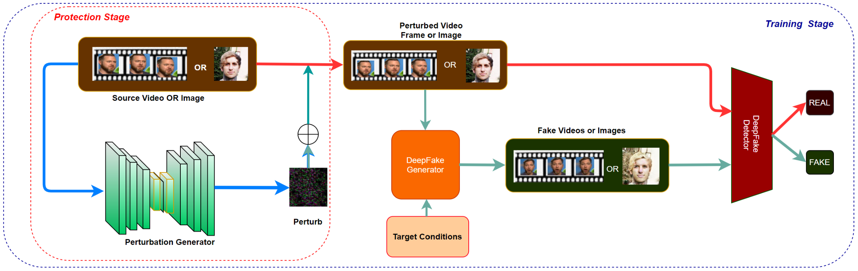
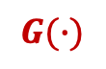



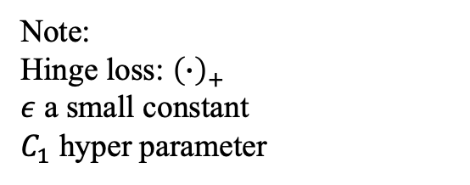
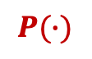
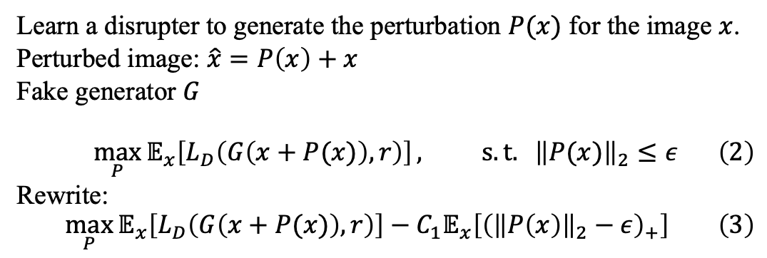
3.2. DeepFake Disrupter
$$x$$
$$\hat{x}$$
$$G(∙)$$
$$P(∙)$$
$$η$$
﻿Learn a disrupter to generate the perturbation $P(x)$ for the image $x$.
Perturbed image: $\hat{x}=P\left(x\right)+x$
Fake generator $G$
$$\begin{aligned}\max_{P}{𝔼_{x}\left[L_{D}\left(G\left(x+P(x)\right),r\right)\right]}, s.t. {\left\|P(x)\right\|}_{2}≤ε\#\left(2\right)\end{aligned}$$
Rewrite:
$$\begin{aligned}\max_{P}{𝔼_{x}\left[L_{D}\left(G\left(x+P(x)\right),r\right)\right]}−C_{1}𝔼_{x}\left[{\left({\left\|P\left(x\right)\right\|}_{2}−ε\right)}_{+}\right]\#\left(3\right)\end{aligned}$$
Note:
Hinge loss: ${\left(∙\right)}_{+}$
$ε$ ﻿a small constant
$C_{1}$ ﻿hyper parameter
Notes:
该方法的模型流程由扰动发生器、深度伪发生器和深度伪检测器组成。接下来我们将逐一介绍，并给出一个整体的优化框架。
由于式(2)中的不等式约束在网络的端到端训练中不能方便地处理，我们进一步得到了目标函数的软约束版本

Slide 10
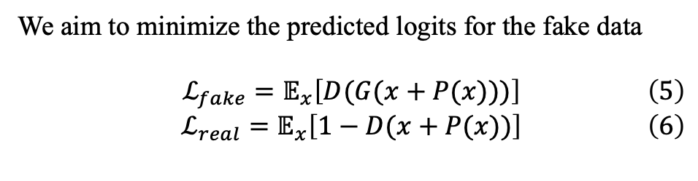
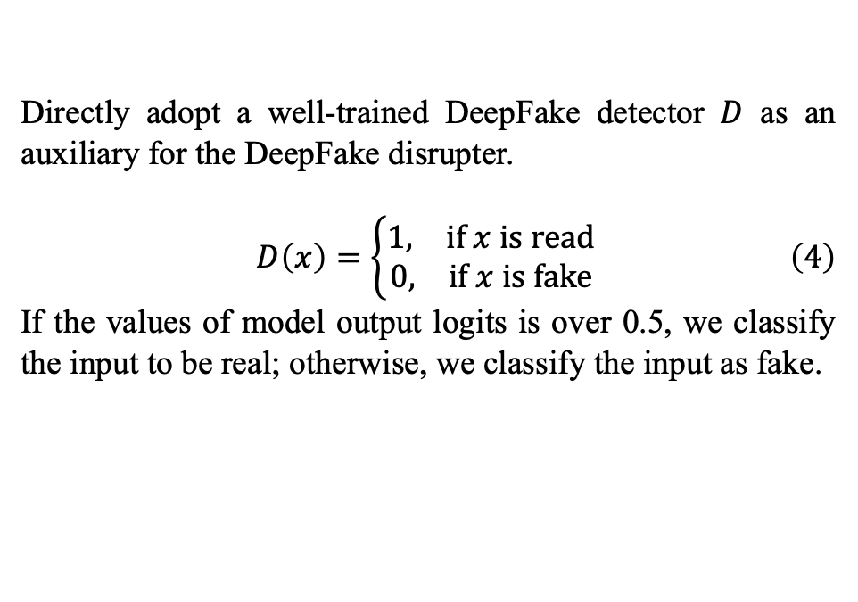
3.2. DeepFake Disrupter
$$x$$
$$\hat{x}$$
$$G(∙)$$
$$P(∙)$$
$$η$$
﻿Directly adopt a well-trained DeepFake detector $D$ as an auxiliary for the DeepFake disrupter.
$$\begin{aligned}D\left(x\right)=\left\{\begin{aligned}\begin{matrix}1, & if x is read\end{matrix} \\ \begin{matrix}0, & if x is fake\end{matrix}\end{aligned}\right.\#\left(4\right)\end{aligned}$$
﻿If the values of model output logits is over 0.5, we classify the input to be real; otherwise, we classify the input as fake.
﻿We aim to minimize the predicted logits for the fake data
$$\begin{aligned}ℒ_{fake}=𝔼_{x}\left[D(G(x+P(x)))\right]\#\left(5\right)\end{aligned}$$
$$\begin{aligned}ℒ_{real}=𝔼_{x}\left[1−D(x+P(x))\right]\#\left(6\right)\end{aligned}$$

Slide 11
3.2. DeepFake Disrupter
$$x$$
$$\hat{x}$$
$$G(∙)$$
$$P(∙)$$
$$η$$
$$\begin{aligned}ℒ=−𝔼_{x}\left[L_{D}\left(G\left(x+P\left(x\right)\right),r\right)\right]+C_{1}𝔼_{x}\left[{\left({\left\|P\left(x\right)\right\|}_{2}−ε\right)}_{+}\right]+C_{2}𝔼_{x}\left[D\left(G\left(x+P\left(x\right)\right)\right)\right]+C_{3}𝔼_{x}\left[1−D\left(x+P\left(x\right)\right)\right]\#\left(7\right)\end{aligned}$$
﻿constrain perturbation
fake
real

Slide 12
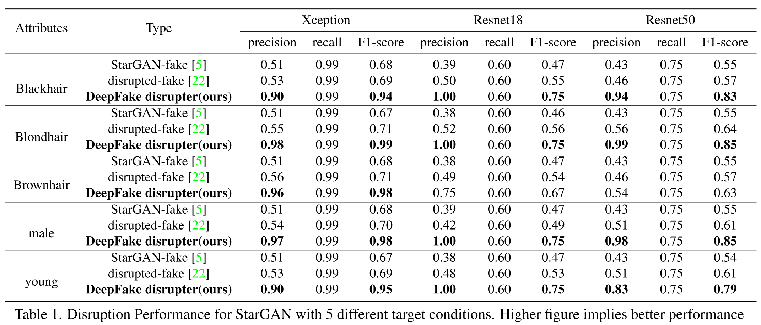
4. Experiment
Compare with SOTA

Slide 13
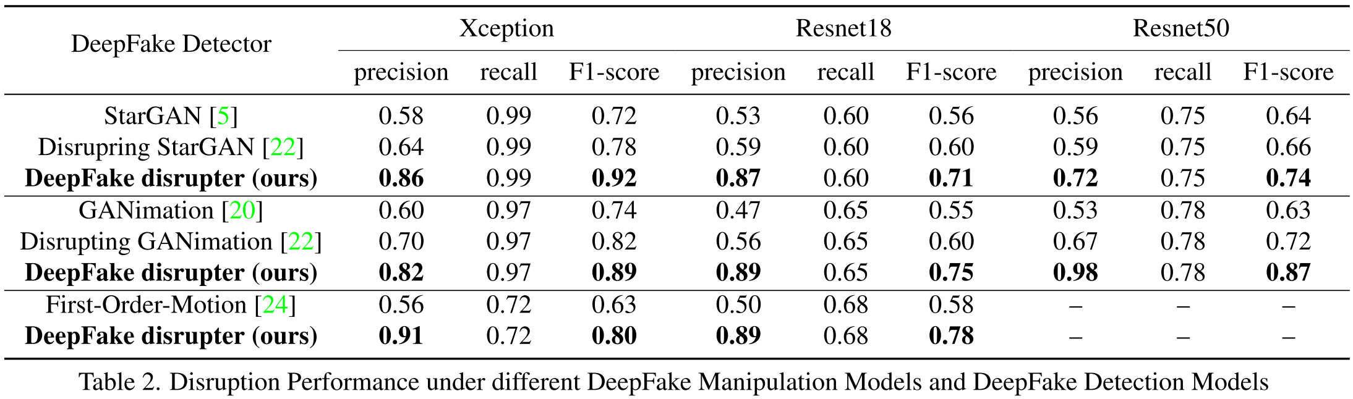
4. Experiment
Compare with SOTA

Slide 14
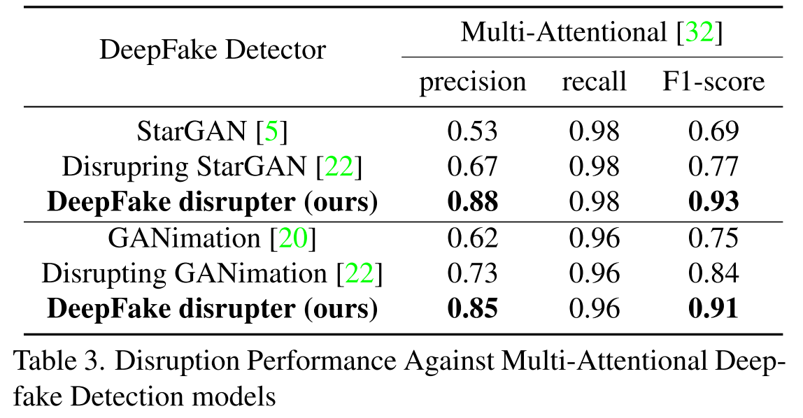
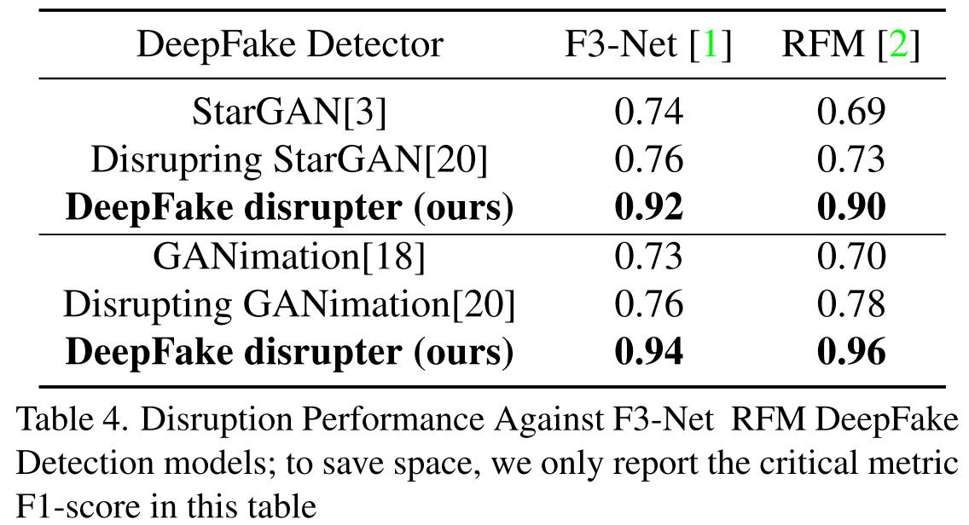
4. Experiment
Plug and play, strong generalization
﻿From Table 3 and 4 we can see our proposed pipeline can achieve similar performance gain in terms of precision.
Notes:
即插即用，泛化性强

Slide 15
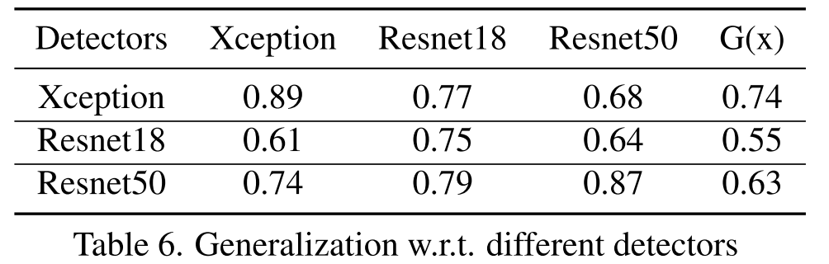
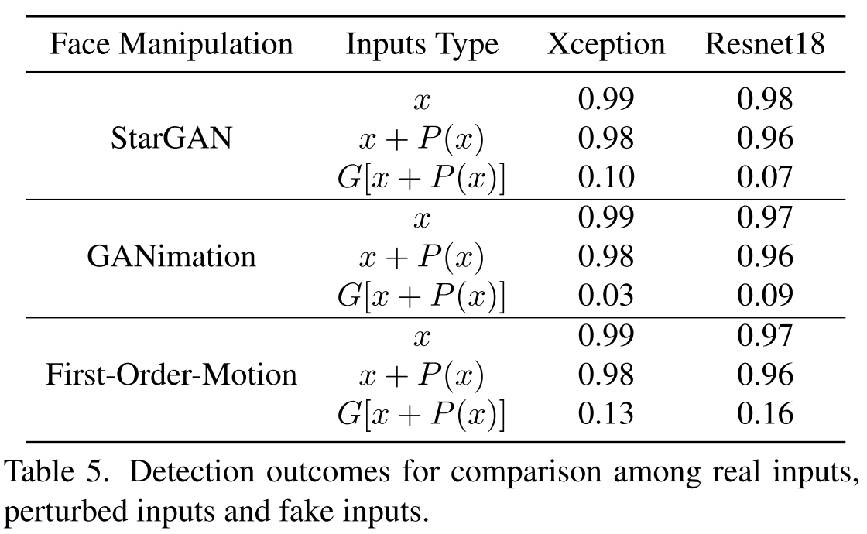
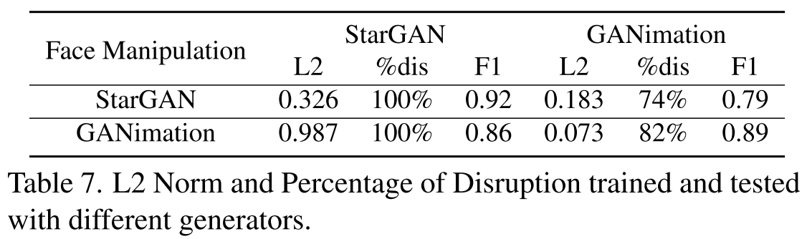
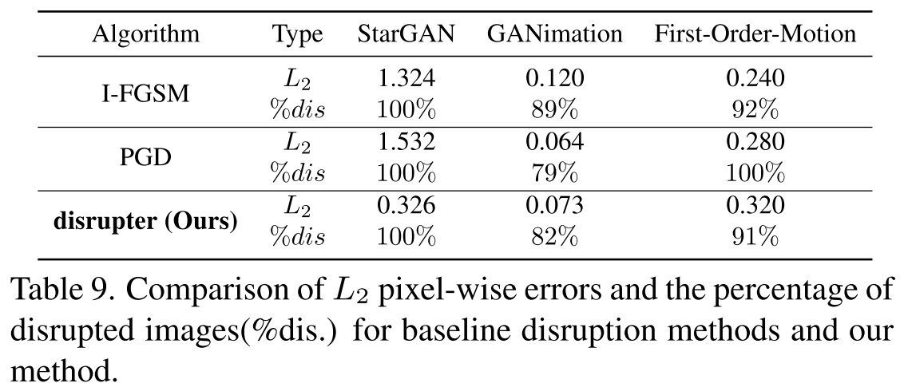
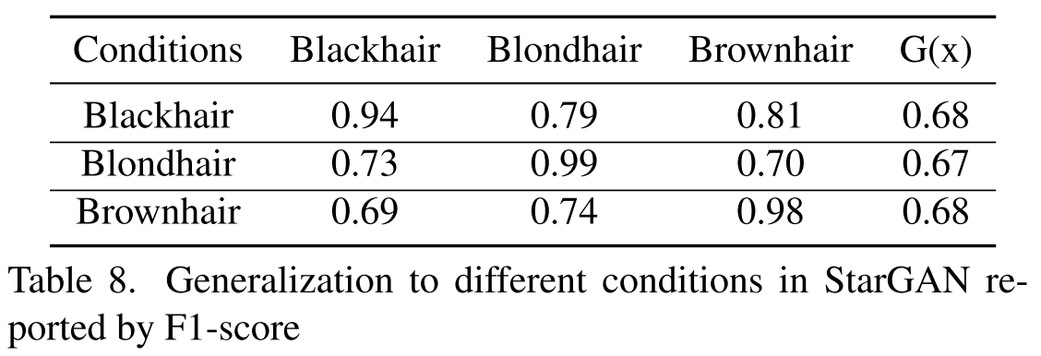
4. Experiment
Ablation study related

Slide 16
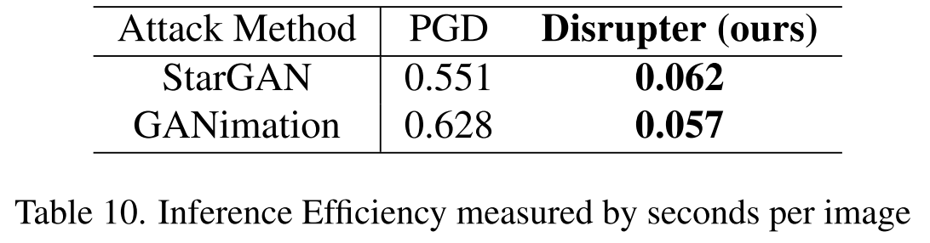
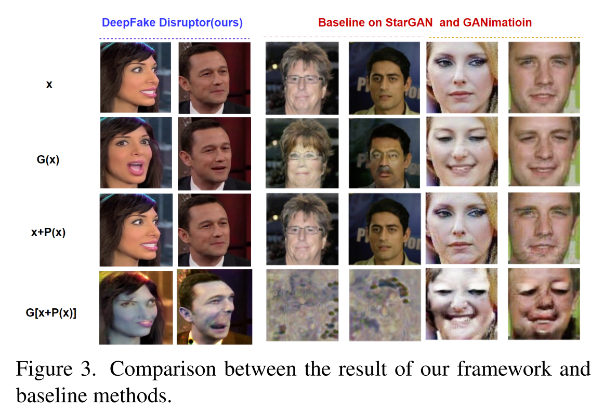
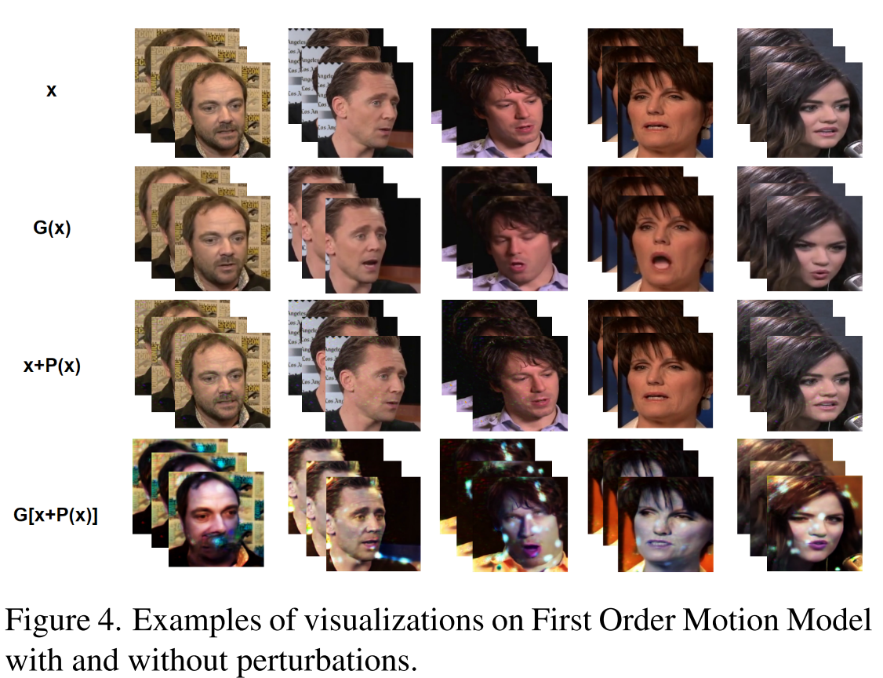
﻿Efficiency
4. Experiment
Visualization

Slide 17
Conclusion
This work proposed a novel framework, called DeepFake Disrupter, to defend against DeepFake with the help of the DeepFake detector.
The DeepFake Disrupter is a perturbation generator that takes as input real images and outputs a human-imperceptible perturbation so as to make the data generated by the DeepFake models be identified as fake by DeepFake detector and human eyes; meanwhile, the original real inputs injected with perturbations can still be identified as real by DeepFake detector.
﻿Experimental results on CelebA [13] and VoxCeleb1 [16] …
Key Technology:
﻿Adversarial attack and Adversarial Training
﻿DeepFake Data Generation
Proposed by this paper
Notes:
DeepFake Disrupter是一种扰动生成器，以真实图像为输入，输出人类难以察觉的扰动，从而使DeepFake模型生成的数据通过DeepFake检测器和人眼识别为假数据

Slide 18
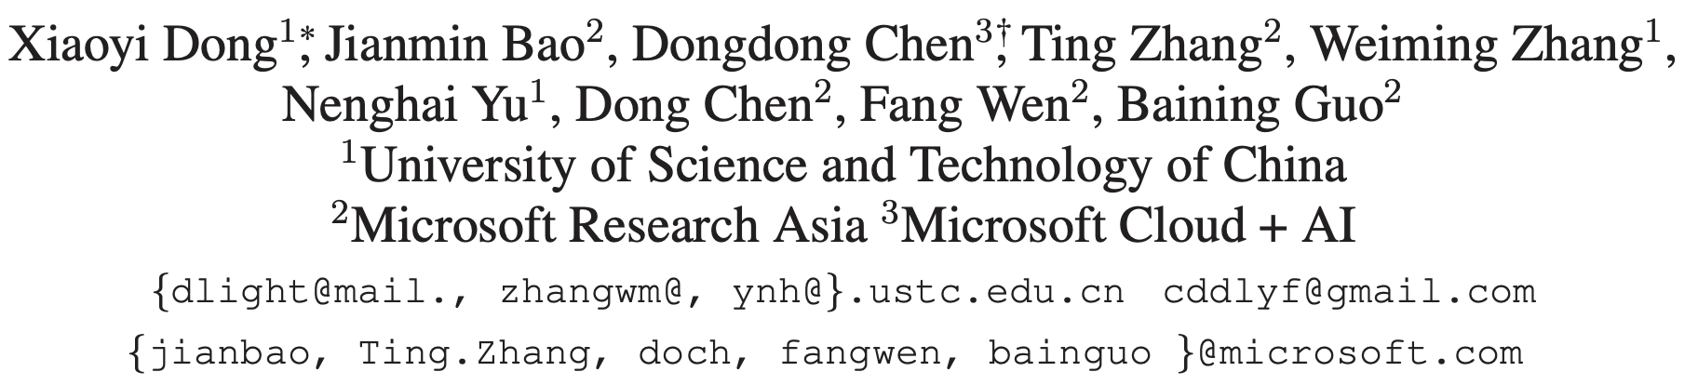
Protecting Celebrities From DeepFake With Identity Consistency Transformer
﻿Code: https://github.com/LightDXY/ICT_DeepFake
CVPR 2022
Notes:
用身份一致性Transformer保护名人免受DeepFake的影响
希望通过大量使用有语义意义的身份信息，使深度假检测的鲁棒性显著提高。

Slide 19
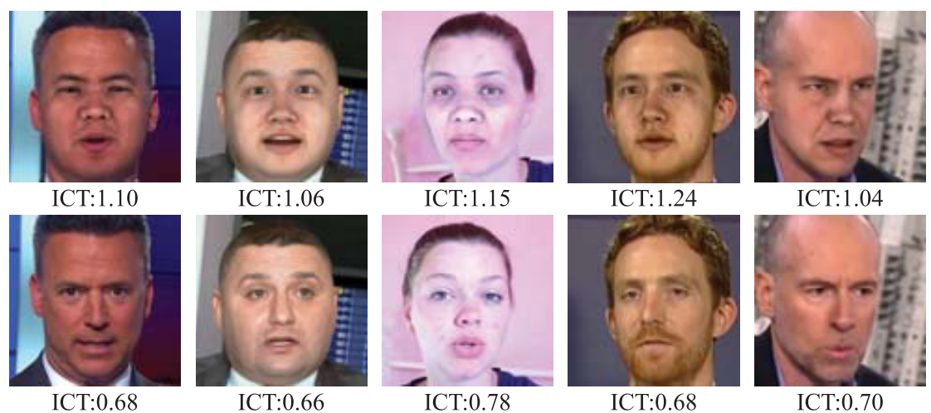
Figure 1. Five fake (1st row) and real (2nd row) faces and their identity consistency scores. Higher ICT score indicates the inner and outer face more likely from two people, i.e. DeepFake face. data.
Notes:
5张假脸(第1排)和真脸(第2排)及其身份一致性得分ICT得分越高，两个人内部脸和外部脸出现的可能性越大，即DeepFake face。

Slide 20
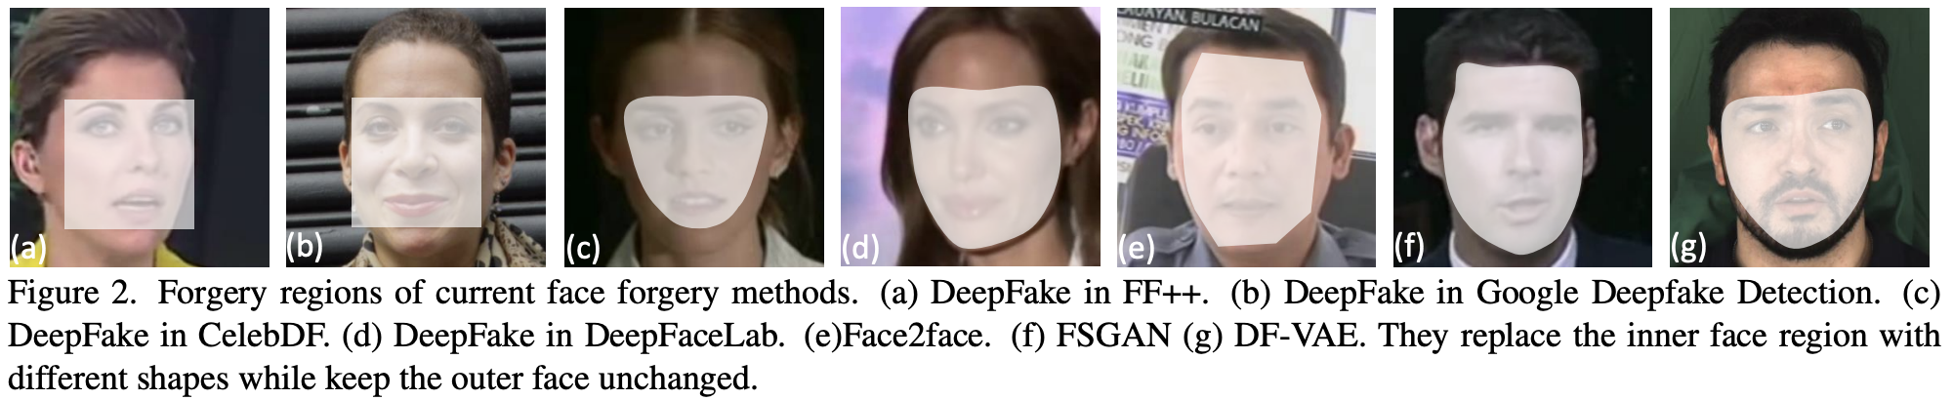
Contribution
This paper proposed a new face forgery detection technique called Identity Consistency Transformer (ICT) based on high-level semantics.
Existing face verification methods tend to characterize the most discriminative region, i.e., the inner face for verification and fail to capture the identity information in the outer face. Identity Consistency Transformer learn a pair of identity vectors, one for the inner face and the other for the outer face.
Another advantage of Identity Consistency Transformer is that it can be easily enhanced with additional identity information when such information happens to be available, as is the case with celebrities.
Notes:
其关键思想是检测嫌疑人图像中的身份一致性，即内部人脸和外部人脸是否属于同一个人。

Slide 21
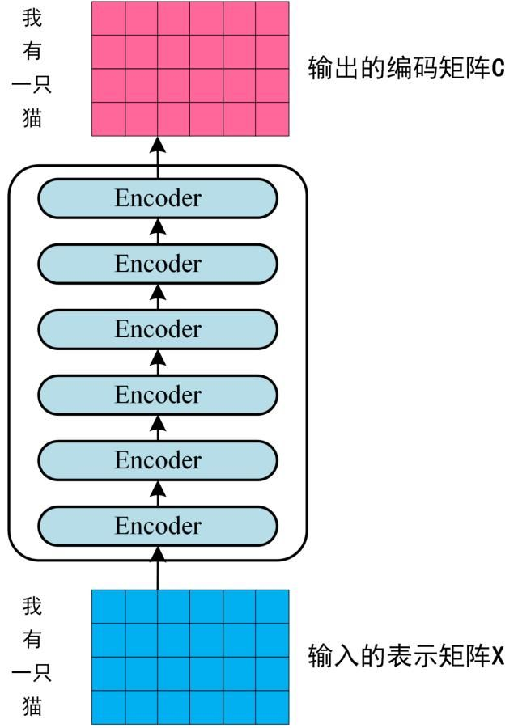
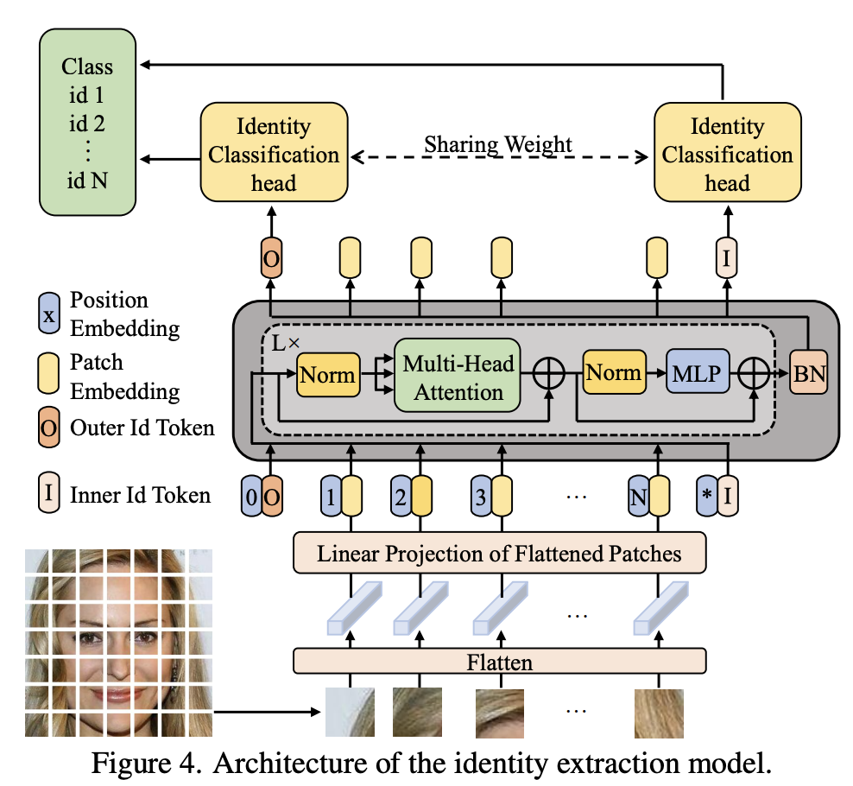
3. Identity Consistency Transformer
3.1. Identity Extraction Model
Notes:
内部身份和外部身份可以通过统一的模型同时学习，而不是采用两个单独的人脸识别模型，每个模型对两个身份中的一个负责。

Slide 22
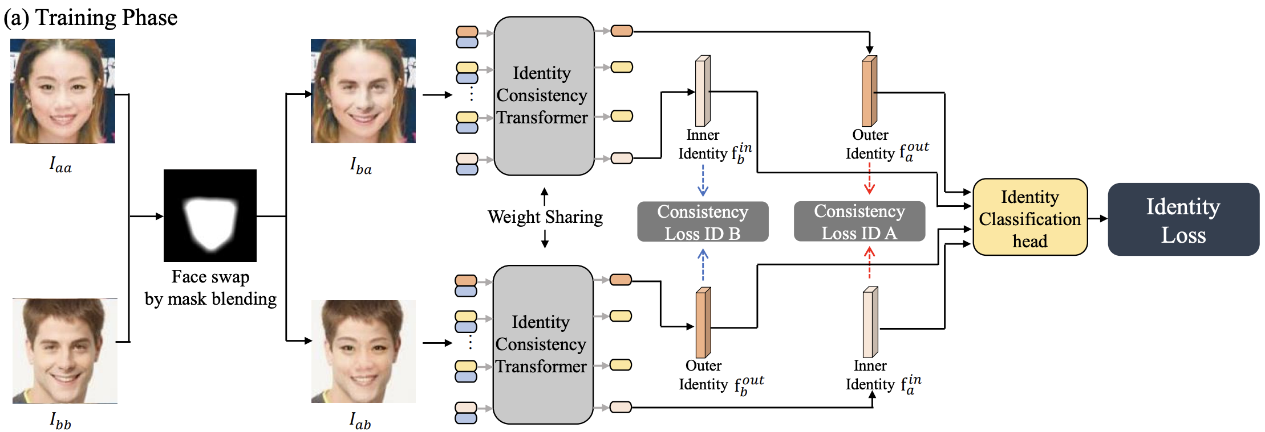
3. Identity Consistency Transformer
3.1. Identity Extraction Model
Create deepfakes by swapping the inner face of two real faces: (Similar to Face X-ray [1])
1) find two faces that has similar poses using face landmarks;
2) generate a mask deformed from the convex hull of the face landmarks;
3) swap the inner face according to the mask after applying color correction.
[1] Lingzhi Li, Jianmin Bao, Ting Zhang, Hao Yang, Dong Chen, Fang Wen, and Baining Guo. Face x-ray for more general face forgery detection, 2020.
Notes:
在我们的实验中，我们只在训练中使用这种交换的面孔。

Slide 23
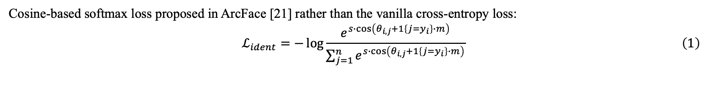
3. Identity Consistency Transformer
3.1. Identity Extraction Model
Cosine-based softmax loss proposed in ArcFace [21] rather than the vanilla cross-entropy loss:
$$\begin{aligned}ℒ_{ident}=−\log{\frac{e^{s∙\cos\left(θ_{i,j}+1\left\{j=y_{i}\right\}∙m\right)}}{\sum_{j=1}^{n}{e^{s∙\cos\left(θ_{i,j}+1\left\{j=y_{i}\right\}∙m\right)}}}}\#\left(1\right)\end{aligned}$$
[21] Jiankang Deng, Jia Guo, Niannan Xue, and Stefanos Zafeiriou. Arcface: Additive angular margin loss for deep face recognition, 2019.
Notes:
在我们的实验中，我们只在训练中使用这种交换的面孔。

Slide 24
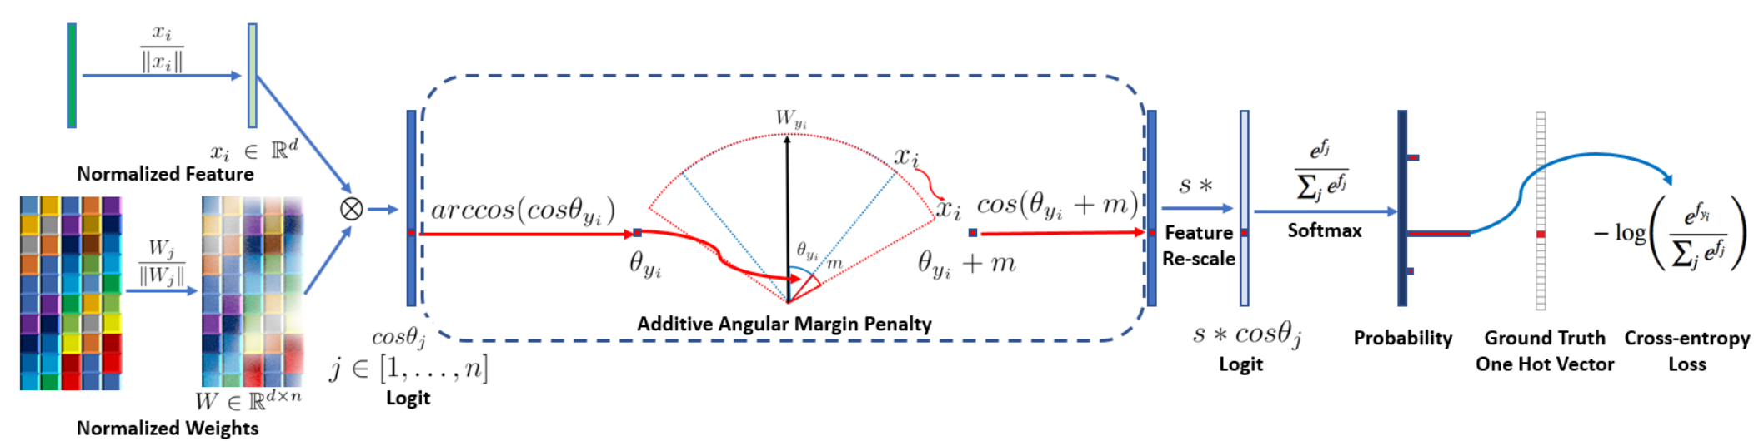
3. Identity Consistency Transformer
3.1. Identity Extraction Model
Cosine-based softmax loss proposed in ArcFace [21] rather than the vanilla cross-entropy loss:
$$\begin{aligned}ℒ_{ident}=−\log{\frac{e^{s∙\cos\left(θ_{i,j}+1\left\{j=y_{i}\right\}∙m\right)}}{\sum_{j=1}^{n}{e^{s∙\cos\left(θ_{i,j}+1\left\{j=y_{i}\right\}∙m\right)}}}}\#\left(1\right)\end{aligned}$$
[21] Jiankang Deng, Jia Guo, Niannan Xue, and Stefanos Zafeiriou. Arcface: Additive angular margin loss for deep face recognition, 2019.
Notes:
在我们的实验中，我们只在训练中使用这种交换的面孔。

Slide 25
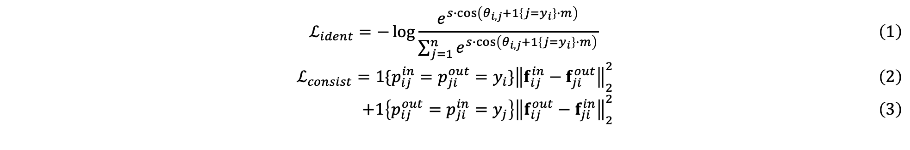
3. Identity Consistency Transformer
3.1. Identity Extraction Model
$$\begin{aligned}ℒ_{ident}=−\log{\frac{e^{s∙\cos\left(θ_{i,j}+1\left\{j=y_{i}\right\}∙m\right)}}{\sum_{j=1}^{n}{e^{s∙\cos\left(θ_{i,j}+1\left\{j=y_{i}\right\}∙m\right)}}}}\#\left(1\right)\end{aligned}$$
$$\begin{aligned}ℒ_{consist}=1\{p_{ij}^{in}=p_{ji}^{out}=y_{i}\}{\left\|f_{ij}^{in}−f_{ji}^{out}\right\|}_{2}^{2}\#\left(2\right)\end{aligned}$$
$$\begin{aligned} +1\left\{p_{ij}^{out}=p_{ji}^{in}=y_{j}\right\}{\left\|f_{ij}^{out}−f_{ji}^{in}\right\|}_{2}^{2}\#\left(3\right)\end{aligned}$$
Notes:
在我们的实验中，我们只在训练中使用这种交换的面孔。

Slide 26
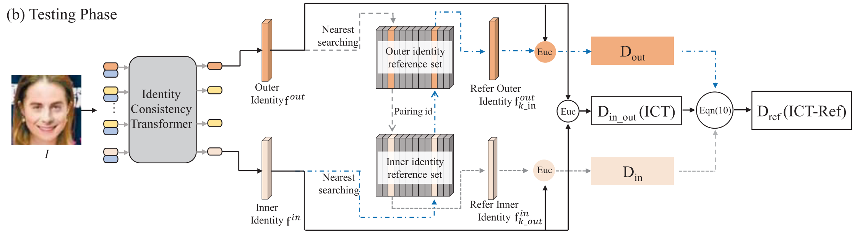

3. Identity Consistency Transformer
3.2. Identity ﻿Consistency Detection
Image $I$
Inner face feature $f^{in}$
Outer face feature $f^{out}$
﻿The distance from inner to outer:
$$\begin{aligned}D_{in_out}=d\left(f^{in},f^{out}\right)\#\left(5\right)\end{aligned}$$
﻿If $D_{in_out}$ is smaller, this suggests that the identity is more consistent and thus the suspect image is more likely to be real.

Slide 27


3. Identity Consistency Transformer
3.2. Identity ﻿Consistency Detection-﻿Reference-assisted identity consistency detection
﻿Why not leverage publicly available real face images in detecting deepfakes?
﻿Reference set: $ℱ={\{\left(f_{n}^{in},f_{n}^{out}\right)=T(I_{n})\}}_{n=1}^{N}$
The ﻿nearest neighbor:
$$\begin{aligned}k^{in}=\arg{\min_{n∈1,…,N}{d(f^{in},f_{n}^{in})}}, α_{in}=d\left(f^{in},f_{k^{in}}^{in}\right)\#\left(6\right)\end{aligned}$$
Comparing the outer identity:
$$\begin{aligned}D_{out}=d\left(f^{out},f_{k^{in}}^{out}\right)\#\left(7\right)\end{aligned}$$
Comparing the inner identity:
$$\begin{aligned}D_{in}=d\left(f^{in},f_{k^{out}}^{in}\right)\#\left(8\right)\end{aligned}$$
$$\begin{aligned}k^{out}=\arg{\min_{n∈1,…,N}{d(f^{out},f_{n}^{out})}}, α_{out}=d\left(f^{out},f_{k^{out}}^{out}\right)\#\left(9\right)\end{aligned}$$

Slide 28

3. Identity Consistency Transformer
3.2. Identity ﻿Consistency Detection-﻿Reference-assisted identity consistency detection
The final reference-assisted identity consistency detection is evaluated by the following measure that is combined from all the distances﻿:
$$\begin{aligned}D_{ref}=λD_{in_out}+ω\left(α_{in}\right)D_{out}+ω\left(α_{out}\right)D_{in}\#\left(10\right)\end{aligned}$$
Where $λ=2.5−ω\left(α_{out}\right)−ω\left(α_{in}\right)$, $ω\left(x\right)=\frac{1}{1+\exp{((x−θ)/τ)}}$, $θ=0.5,τ=0.5$

Slide 29


4. Experience
Compare with SOTA

Slide 30

4. Experience
﻿Generalization

Slide 31



4. Experience
﻿Ablation Study

Slide 32

4. Experience
Visualization

Slide 33

Review

Slide 34

Celeb-DF: A Large-scale Challenging Dataset for DeepFake Forensics
CVPR 2020
Notes:
提出了一个大规模deepfake数据集Celeb-DF

Slide 35

Motivation
The development and evaluation of DeepFake detection algorithms calls for large-scale datasets.
However, the existing DeepFake datasets suffer from low visual quality and do not resemble DeepFake videos circulated on the Internet.
UADFA dataset
Contribution
This paper present a new large-scale and challenging DeepFake video dataset, Celeb-DF, for the development and evaluation of DeepFake detection algorithms.
Notes:
Motivation:
DeepFake的发展已经严重影响到了社会的公序良俗，所以很多研究人员着手于检测伪造人脸，而伪造检测算法的研究和评估需要大规模的数据集。
现有的DeepFake数据集存在质量低的问题，如有明显的伪影和拼接面，下图是选自UADFA数据集的示例，这些伪造很容易被检测，和现实中互联网上传播的伪造视频相比有着明显的差距。
Contribution：
提供了一个大规模有挑战性的深度伪造视频数据集，Celeb-DF

Slide 36

Method
Basic model(Auto-encoder)
Notes:
首先介绍DeepFake中经典的自编码器模型(Auto-encoder)，本文使用的伪造方法是基于此方法改进得到的。图3左边这部分是人脸替换的整个流程，首先对原图像中的人脸进行定位，标定landmark，然后对人脸进行对齐裁剪，将裁剪后的人脸输入共享的encoder，得到嵌入向量，用特定的解码器D_1对该嵌入向量解码，得到D_1对应身份的人脸，将该人脸通过mask覆盖到原图像上，再进行边缘平滑的后处理。
图3右边是编码器和解码器的训练过程，为了提取人脸中的公共特征，每个身份使用共享的编码器(E)，得到嵌入向量后再用对应身份的解码器(D_1,D_2)进行解码，计算解码后的图像与原图像的重构误差(L1 loss)进行训练。还可以对原图片加一些扭曲操作，增加模型的学习难度，已达到更好的训练效果。

Slide 37

Method
Improvements
Low resolution
Adding layers to encoder and decoder models and increasing dimensions.
Color mismatch
1. Randomly perturbing the colors of the training faces.
2. A color transfer algorithm.
Temporal flickering
Kalman smoothing algorithm.
DeepFake frames using synthesized face without (left) and with (right) color correction.
Notes:
这篇论文并没有公布伪造模型的源码和具体细节，只是介绍了改进方向和方法。
低分辨率，基础的伪造模型生成的往往是低分辨率的伪造视频，这一点可以通过增加编码器、解码器的层数和扩展维度解决。
颜色不匹配。如图中左边图片所示，基础的伪造模型生成的合成人脸会出现脸部颜色不一致的现象。这篇论文采取了两个措施，首先在训练阶段，对人脸进行颜色的扰动，迫使模型学习如何重建出颜色，其次是使用颜色转移算法，对合成人脸进行后处理，效果如图中右边图片所示。
时序闪烁。由于伪造模型是逐帧生成的，伪造视频的帧间可能会出现不连贯的闪烁现象，这篇文章使用卡尔曼平滑算法对人脸landmark的时序序列进行过滤。

Slide 38

Method
Improvements
Inaccurate face masks
Synthesizing a face with more surrounding context, so as to completely cover the original facial parts after warping.
Notes:
4. 人脸mask生成不准确。如右图中第一二行所示，在之前数据集中，mask要么是矩形，要么是眼眉和下唇上landmark的凸包(convex hull)，这些mask都会产生拼接不自然的现象，如图中所示的边缘现象。为了解决这个问题，如图中第三行所示，这篇论文先使用下唇和下巴的landmark进行插值，将插值后的点再与眼眉上的landmark进行插值，最后连接眼眉上的landmark和插值点，得到mask。这样提取了更多的人脸区域进行覆盖。

Slide 39

Dataset
Visualization
Notes:
数据集视觉效果。最左边一列绿色框的是真实图像，其余红色框的是用不同人脸合成的图像，与之前的数据集相比，质量明显更高。

Slide 40

Two-branch Recurrent Network for Isolating Deepfakes in Videos
ECCV 2020
Notes:
设计了一个双分支结构来提取丰富特征，并通过设计损失函数学习到了一个更具有区分性的嵌入空间

Slide 41
Motivation
The current spike of hyper-realistic faces artificially generated using deepfakes calls for media forensics solutions that are tailored to video streams and work reliably with a low false alarm rate at the video level.
Contribution
A two-branch representation extractor based on densely connected layers that learns to combine information from the color domain and the frequency domain using a multi-scale Laplacian of Gaussian (LoG) operator.
A novel loss function that encourages compactness of the representations of natural faces and pushes away manipulated faces for better, wider separation boundaries, which is different than recent methods that use binary cross-entropy for detecting face manipulations.
Notes:
Motivation:目前，使用deepfakes人工生成的伪造人脸数量激增，这就需要设计针对视频流的媒体取证解决方案，并在视频级别以较低的误报率可靠地工作。
Contribution：1. 提出了一种新颖的双流网络，一路使用普通的RGB图像，一路使用LOG算子后的图像，LOG算子可以抑制图像low level特征图中的内容信息，放大伪影。
2. 设计了一种新的损失函数，使真人脸在特征空间分布更加聚集，并且推远与伪造人脸的距离，形成一个更宽的分离边界

Slide 42



Method
Overview of video-based face manipulation detection model.
Aligned video frames $I∈R^{H×W×3×F}$
Embedding $Φ\left(I\right)∈R^{D}$
Deep LoG: $x^{′}=w_{1×1}(x−up(down(\overline{w}𝒩_{2D} x)))$
Notes:
这是本文所提出的双分支模型的整体架构，该模型的任务是将人脸对齐后的一系列帧$I$映射到一个有区分性的D维嵌入空间$φ\left(I\right)$中，在这个空间中，真人脸聚集在一个质心周围，伪造人脸则尽可能远离该质心。模型上面的分支使用LOG后的图像，Deep LoG的实现如下面公式所示，$\overline{w}𝒩_{2D}$是高斯核，$x$为前一层的输出，up和down分别是上采样和下采样操作，$w_{1×1}$是1x1的卷积，用于将维度降到Dense Block要求的维度，Dense Block用于提取该分支的特征。模型下面的分支使用普通卷积和RGB图像进行特征提取，最后将两个分支提取到的特征使用point-wise convolution进行融合，将融合后的特征输入一系列Dense Block进一步提取特征，最后通过全局平均池化压缩为特征向量，将特征向量输入双向LSTM，将输出进行Concat得到最后的D维嵌入向量。

Slide 43






Method
Diverse feature maps from two branches
Loss
$c∈R^{D}$ : center by averaging the encodings of all the natural face sequences in the training set.
Natural embeddings: in hyperspheres $𝕊^{D−1}(c, r^{−})$
Manipulated embeddings: out of hyperspheres $𝕊^{D−1}(c, r^{+})$
$$L=\frac{1}{|Ω_{nat.}|}\sum_{i∈Ω_{nat.}}{\max\left(0, {\left\|Φ\left(I_{i}−c\right)\right\|}_{2}−r^{−}\right)+} \\ \frac{1}{|Ω_{man.}|}\sum_{j∈Ω_{man..}}{max⁡(0, r^{+}−{\left\|Φ\left(I_{j}−c\right)\right\|}_{2})}$$
where $Ω∈R^{H×W×3×F×B}$, $Ω_{nat.}$ $Ω_{man.}$ means natural and manipulated face samples.
Notes:
上图为两个分支提取特征的可视化结果，LOG提取的是高频(边缘)信息，会放大伪影，RGB提取的是脸部的整体结构。
下面是本文设计的loss函数，左图为损失函数的示意图，在正式训练之前，首先用预训练好的模型对真实人脸序列进行嵌入，取平均计算出聚集中心$c$。然后通过下面这个损失函数将mini-batch中真实人脸的嵌入向量限制在以$c$为中心，$r^{−}$为半径的超球内，同时将被修改过的假人脸的嵌入向量约束在以$c$为中心，$r^{+}$为半径的超球之外。在测试阶段，通过测试样本的嵌入向量与中心$c$的距离来判断其属于真实人脸的概率，距离越近，越有可能是真实人脸。

Slide 44

Exploring Adversarial Fake Images on Face Manifold
CVPR 2021
Notes:
设计了一种针对取证模型的对抗样本制作方法

Slide 45

Motivation
﻿Manipulated or generated fake images may draw social and privacy concern if being abused by malicious attackers.
Although image forensic models have reached great performance in detecting fake images from real ones, these models can be easily fooled with a simple adversarial attack.
Notes:
Motivation
1.恶意攻击者操纵或生成虚假图像可能会造成社会和隐私问题。
2.尽管图像取证模型可以很好地从真实图像中检测出虚假图像，但这些模型很容易被简单的对抗性攻击所欺骗。

Slide 46
Contribution
﻿We compare our method with nowadays widely-applied norm-based adversarial attacks and show that the proposed method can achieve the same attack success rate while introducing less visible perturbation, making it harder for our adversarial image to be detected by human eyes.
We conduct our attack in different ensemble ways and have shown our adversarial images can transfer between different forensic models, causing a threat even in the situation where the architecture of forensic models is unknown to the attacker.
Notes:
1.将本文的方法与当今广泛应用的基于规则的对抗性攻击进行比较，本文的方法可以达到相同的攻击成功率，并且引入较少可见的扰动，使得本方法的对抗性图像更难被人眼检测到
2.本方法以不同的集成方式进行攻击，本方法的对抗性图像可以在不同的取证模型之间迁移，即使在攻击者不知道取证模型架构的情况下也能造成威胁

Slide 47

Method
Notes:
Style-GAN可以生成高度逼真的图像，但其容易被取证模型给检测到。本文保持Style-GAN的原始架构不变，尝试生成可以欺骗取证检测器并且不会降低质量的虚假图像。
Style-GAN架构由一个8层的线性映射网络f和生成器g组成，f将潜在向量z映射到中间样式（style）空间以获得样式（style）向量w，而生成器g的每一层将样式（style）向量和随机噪声作为输入并逐步生成图像。
本方法对噪声和潜在的Style-GAN向量应用梯度下降，并且朝着最大化取证模型预测损失的方向更新这些向量。每次更新后，都会验证取证检测器是否将假图像预测为真实图像。由于伪造图像检测任务其实是一个二分类问题，因此非目标方法就足够了。如果目标检测模型将我们生成的图像误分类为真实图像，我们就成功了绕过检测模型。
而为了提高本方法生成对抗性图像的攻击成功率，本方法进行集成攻击。我们以三种不同的方法组织集成攻击方法：交替攻击方式、损失集成和网络预测 logits 集成。梯度集成可以有效地避免搜索到局部最大值。

Slide 48

Artificial Fingerprinting for Generative Models:
Rooting Deepfake Attribution in Training Data
ICCV 2021
Notes:
证明了人工指纹可以从训练数据迁移到生成模型中，并出现在所有伪造数据中，通过人工指纹可以对deepfake进行检测和溯源

Slide 49
Motivation
The misuse of deepfakes has been permeating to each corner of social media, ranging from misinformation of political campaigns to fake journalism. This motivates tremendous research efforts on deepfake detection and source attribution .
Contribution
We synergize the two previously uncorrelated domains, image steganography and GANs, and propose the first proactive and sustainable solution for the third emerging domain, deepfake detection and attribution.
This is the first study to demonstrate the transferability of artificial fingerprints from training data to generative models and then to all the generated deepfakes. Our discovery is non-trivial: only deep-learning-based fingerprinting techniques are transferable to generative models, while conventional steganography and watermarking techniques are not.
Notes:
Motivation
deepfake 的滥用已经渗透到社交媒体的每个角落，从政治运动的错误信息 到假新闻。这激发了对 deepfake 检测 和来源归属的巨大研究动力
Contribution
1.本文将之前不相关的两个领域——图像隐写术和 GAN 进行协同，并为第三个新兴领域——深度伪造检测和归属提出了第一个主动且可持续的解决方案。
2.这是第一个证明人工指纹从训练数据到生成模型然后到所有生成的深度伪造的可转移性的研究。本文发现：只有基于深度学习的指纹技术可以转移到生成模型，而传统的隐写术和水印技术则不能。

Slide 50

Method
The goal of image attribution is to learn a mapping $D_{0}\left(\text{x}\right)↦y$ that traces the source $y ∈ 𝕐=\left\{real, G_{1}, …, G_{N}\right\}$ of an image x.
To generalize our solution to being agnostic to the selection of generative models, we formulate the attribution as a regression mapping $D\left(\text{x}\right)↦w$, where $w∈\{0,1\}^{n}$ is the source identity space and n is the dimension.
Notes:
图像归属的目标是学习一个映射$D_{0}\left(\text{x}\right)↦y$，它跟踪图像 x 的源$y ∈ 𝕐=\left\{real, G_{1}, …, G_{N}\right\}$，我们将归属表述为一个多标签分类问题，每个标签对应一个源。
为了将本方法推广到与生成模型的选择无关，我们将归因公式化为回归映射 $D\left(\text{x}\right)↦w$，其中 $w∈\{0,1\}^{n}$是源身份空间，n 是维度。
本方法由四个阶段组成。首先训练一个图像隐写编码器和解码器。然后使用编码器将人工指纹嵌入到训练数据中。之后使用其原始协议训练生成模型。最后，从生成的 deepfakes 中解码指纹。

Slide 51

Method
$$\min_{E,D}{E_{\tilde{x}∼\tilde{x},w∼\{𝟘,𝟙\}^{n}}}L_{BCE}\left(\tilde{x},w;E,D\right)+λL_{MSE}\left(\tilde{x},w;E\right) \text{（}\text{1}\text{）}$$
$L_{MSE}\left(\tilde{x},w;E\right)=|E\left(\tilde{x},w\right)−\tilde{x}|_{2}^{2}$ （3）
$L_{BCE}\left(\tilde{x},w;E,D\right)=\frac{1}{n}\sum_{k=1}^{n}{\left(w_{k}\log{{\hat{w}}_{k}}+\left(1−w_{k}\right)\log\left(1−{\hat{w}}_{k}\right)\right)}$（2）
$\hat{w}=D\left(E\left(\tilde{x},w\right)\right)$ （4）
Notes:
源身份由人工指纹 w 表示。我们使用隐写术系统 来学习编码器$E\left(\tilde{x},w\right)↦{\tilde{x}}_{w}$，它将任意指纹 w（在训练期间随机采样）嵌入到任意图像$\tilde{x}$中。将 E 与解码器 $D\left({\tilde{x}}_{w}\right)↦w$耦合以从图像中检测指纹信息。 E 和 D 被表述为如图所示具有这些训练损失的卷积神经网络，其中$w_{k}$和${\hat{w}}_{k}$分别是输入指纹和检测指纹的第 k 位，λ 是平衡两个客观项的超参数，二进制交叉熵项 $L_{BCE}$ 指导解码器对编码器嵌入的指纹进行解码，均方误差项 $L_{MSE}$会惩罚隐秘图像 $E\left(\tilde{x},w\right)$与原始图像 $\tilde{x}$ 的任何偏差

Slide 52

Thank you for listening
汇报人：陈若愚
组员：朱子璇，赵剑儒
2022-06-20

